Slide 1
Braun Brelin
20+ Years Experience
Silicon Valley Organisations including Sun Microsystems & Network Appliance
Government Institutions and Global Financial Firms
Cryptocurrencies and Machine Learning

Slide 2

Introduction to Machine Learning
A type of Artificial Intelligence
A construction and study of systems that learn from data
Seen as building blocks to make computers learn to behave more intelligently.
A theoretical concept. Various techniques and algorithms and various implementations

Slide 3

Today’s Agenda
Terminology
Types of Machine Learning
Key Tasks and Tools
Algorithms and APIs
Neural Networks
Demo and Case-Study – Fraud Detection
Introduction to Machine Learning

Slide 4

Introduction to Machine Learning
An ML program learns from experience (E) with some class of tasks (T) and a performance measurement (P) if its performance at T as measured by P improves with E.
Introduction to Machine Learning

Slide 5
Terminology #1
Features.
The number of features or distinct traits that can be used to describe each item in a quantative manner.
Samples.
An item of data to process.
Samples can come from documents, pictures, sound files, or as a row in a database or CSV file.
Introduction to Machine Learning

Slide 6
Terminology #2
Feature Vector
An n-dimensional vector of numerical features that represent some object.
Feature extraction
Preparation of the feature vector
Transforms the data in a high dimensional space to a space of fewer dimensions.
Introduction to Machine Learning

Slide 7
Terminology #3
Training/Evolution set
Set of data to discover potentially predictive relationships
Testing set
Set of data that is used to test how well the machine learning model behaves with non-training data.
Introduction to Machine Learning

Slide 8
Types of Learning
Supervised Learning
Teaching a model where you already know the answers.
Semi-supervised learning
Used where not all data is labelled. Many real world problems fall into this category. Use a mix of supervised and unsupervised learning algorithms here.
Unsupervised learning
Training a model where you don’t know what types of results to expect.
Introduction to Machine Learning

Slide 9
Supervised Learning
Two major types of supervised learning
Prediction
Classification
Prediction
Attempting to predict the value of a continuous dependent variable based on the values of one or more independent variables.
Classification
Attempt to separate a dependent variable into one category or another based on the value of one or more independent variables.
Introduction to Machine Learning

Slide 10
Unsupervised Learning
Clustering
Teaching a model where you don’t already know the answers. Algorithms such as K-Means clustering can be used
Association
Attempting to associate different data samples, such as a customer purchasing product X also purchases product Y
Introduction to Machine Learning

Slide 11
ML Task Allocation
Most Machine Learning professionals spend their time on non-ML tasks.
The following graph shows that nearly 80 per cent of their time is spent on data acquisition and data cleansing.
Introduction to Machine Learning

Slide 12
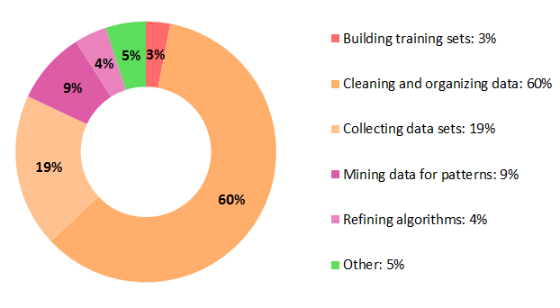
How ML Professionals spend their time
Introduction to Machine Learning

Slide 13
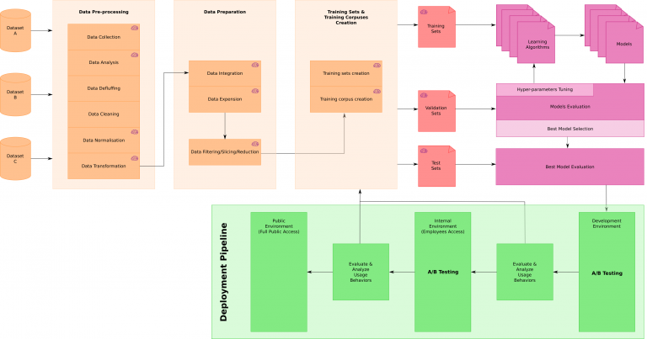
A sample ML workflow
Introduction to Machine Learning

Slide 14
ML Task Allocation
The workflow is split into four general areas.
1. Data Processing
2. Training and testing set creation
3. Machine Learning Algorithm testing and evaluation
4. Deployment and A/B testing
Introduction to Machine Learning

Slide 15
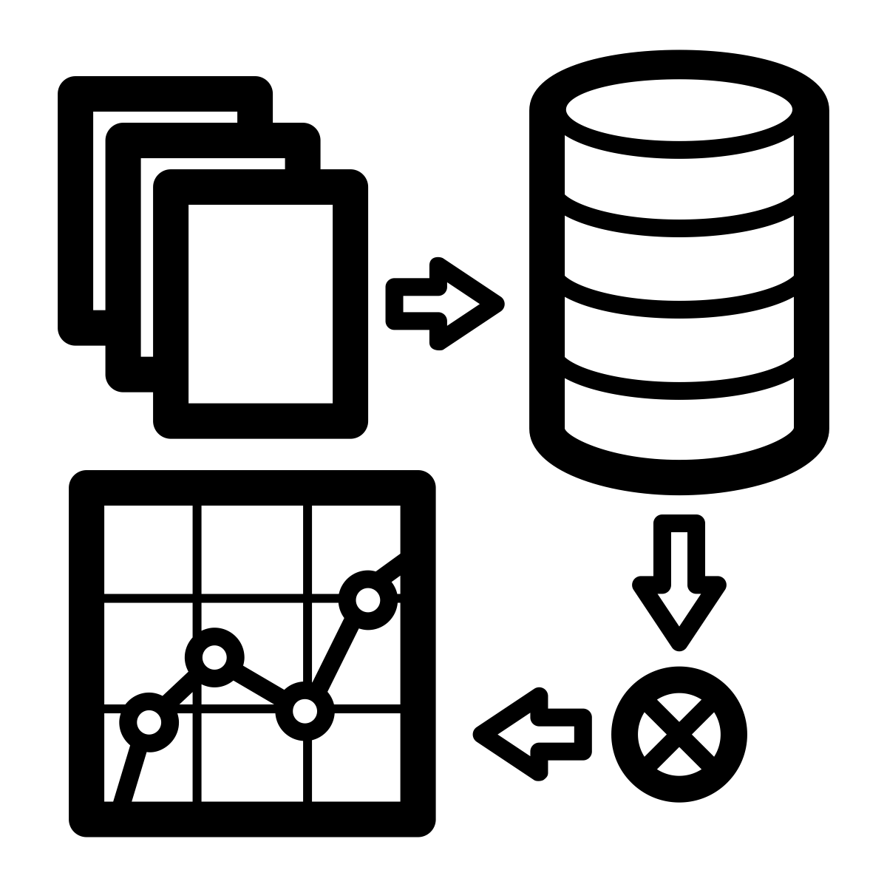
ML Data Processing
Data Processing is defined as
1. Data Acquisition
2. Data Analysis
3. Data Normalization
4. Data Transformation
5. Data Integration
6. Data Filtering/Slicing/Reduction
Introduction to Machine Learning

Slide 16

Evaluating ML Algorithms
We test various algorithms to create different models.
We evaluate them and fine-tune our hyper parameters.
Once we have selected the most accurate model(s), we can deploy them using standard DevOps tools in the deployment tool chain.
Introduction to Machine Learning

Slide 17

Tools for data acquisition, cleansing and analysis
1. Python
2. Pandas
3. Numpy
4. Matplotlib
5. Seaborn
Introduction to Machine Learning

Slide 18

Machine Learning APIs
1. TensorFlow
2. Sci-Kit Learn
3. Theano
4. Keras (Front end for both Tensorflow and Theano)
Introduction to Machine Learning

Slide 19
TensorFlow
TensorFlow is a Machine Learning toolkit from Google.
Written in C++ with bindings for many languages, including Python
Uses the concept of a Directed Acyclic Graph
Somewhat low level with a fairly steep learning curve.
Specifically designed for Neural Network implementations.
Introduction to Machine Learning

Slide 20
Scikit Learn
Python specific toolkit
Extremely easy to program and use
Less support for Neural Networks than TensorFlow
No support for graphics cards
Introduction to Machine Learning

Slide 21
Theano
Python specific toolkit.
Developed at the University of Montreal
Better performance for many algorithms than Tensorflow
Introduction to Machine Learning

Slide 22
Regression Algorithms #1
These algorithms attempt to create a “best fit” line through a graph of points
Standard linear regression uses the y=mx + b equation to fit the line.
Cost function is usually least mean squares, but can also be absolute value (L1 Norm)
We use gradient descent to find the minima of the cost function.
Introduction to Machine Learning

Slide 23
Regression Algorithms #2
We use other linear regression algorithms, such as Ridge regression, if there is a high degree of multicollinearity between the independent variables to reduce the variance.
We can evaluate the performance of our algorithms by calculating the coefficient of determination (R squared).
Introduction to Machine Learning

Slide 24
Regression Algorithms #3
There must be a linear relationship between the dependent and independent variable.
Linear Regression is very sensitive to outliers.
Data analysis should take into account any issues with heteroskedasticity or multicollinearity.
Introduction to Machine Learning

Slide 25
Classification Algorithms #1
Most common algorithm for classification is logistic regression
The name is a misnomer, as it isn’t doing any regression, but the term is in common usage.
Logistic regression uses an exponential algorithm rather than a linear one.
Also, a different cost function.
Introduction to Machine Learning

Slide 26
Classification Algorithms #2
Logistic regression doesn’t require a linear relationship between dependent and independent variables.
Include all significant variables to avoid overfitting or underfitting.
Generally requires large sample sizes because maximum likelihood estimates work better.
Independent variables should not be correlated.
Introduction to Machine Learning

Slide 27
Which Model To Choose?
Data exploration is a critical part of building these models, especially the predictive ones.
Use different metrics to analyze performance, such as R-Squared, adjusted R squared, AIC, or BIC. Use these to check for possible bias in the model.
Use cross-validation to evaluate the models.
Apply the proper regression algorithms, such as Ridge, Lasso and others.
Introduction to Machine Learning

Slide 28

Neural Networks #1
Neural Network origins began with the concept of the Perceptron.
Perceptrons multiply a weight and input value and add a bias, then send it through an activation function.
This function returns a 1 or a 0.
Perceptrons are limited. Can’t handle non-linear problems, such as the classic XOR problem.
Introduction to Machine Learning

Slide 29
Neural Networks #2
Neural Networks first gained prominence in the 1980s with the publication of Geoff Hinton’s paper on back propagation.
However, limitations in processing power and data storage made NN’s non-viable for production systems.
In 2012, Geoff Hinton publishes another paper showing a Convolution Neural Network solving image recognition problems.
Neural Networks gain significant popularity.
Introduction to Machine Learning

Slide 30
Neural Networks #3
Deep Neural networks are networks that contain an input layer, one or more hidden layers, and an output layer.
Several subtypes of NN’s, appear, such as Convolutional NN’s and Recurrent NN’s.
Most popular activation function for DNN’s now is RELU. Others, such as tanh are losing popularity.
Rectilinear Units are chosen for performance reasons.
Introduction to Machine Learning

Slide 31
Convolutional Neural Networks
Standard DNN’s don’t work well for tasks such as image recognition.
Large images can have 100 million inputs. Not really possible to create a fully connected DNN for these.
Convolutional Neural Networks are modelled on how the human eye works.
Introduction to Machine Learning

Slide 32
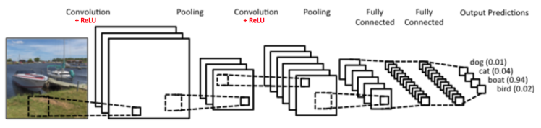
Convolutional Neural Networks #1
Introduction to Machine Learning

Slide 33
Convolutional Neural Networks #2
CNN’s use the concept of filters and pooling to reduce the image size and only pass along relevant image features to the fully connected layer.
Hyperparameters for a CNN include stride and filter size.
ReLU activation functions are the most commonly used as performance is significantly better than with sigmoid or tanh.
Introduction to Machine Learning

